Slide 1





Used Cars Platform
Abduallah Hussien

Slide 2
Table of contents
Introduction | What is the project objectives?
Architecture | Description to system architecture
Implementation | Explanation of techniques used
Demo | Running demo of the work so far
Future Work | Some future actions for enhancments

Slide 3
Introduction

Slide 4
Project Stages
Data Ingestion
Data Transformation
Reporting
Automatically transfer raw data from a GCS bucket to a BigQuery dataset using Apache Airflow.
Convert the raw data into a star schema dimensional model using DBT to improve data querying and analysis.
Leverage the star schema model to create an interactive and informative Power BI dashboard for data analysis and reporting.

Slide 5
Architecture

Slide 6
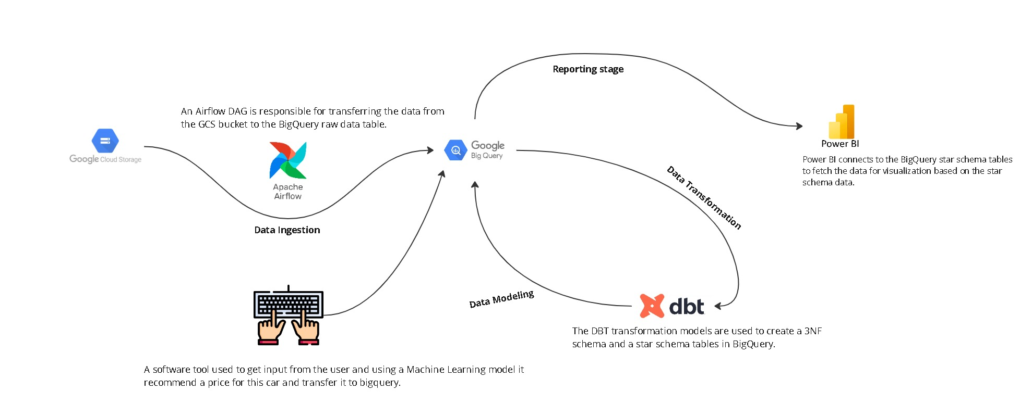
System Architecture

Slide 7
Key components of the system
01
02
Apache Airflow
GCS Bucket
Used cars platform
03
04
BigQuery
DBT
05
06
Power BI
Tkinter

Slide 8
Implementation

Slide 9
Implementation stages
04
03
Develop a ML model
ML model to predict the estimated price of the used car based on the inputs.
02
Develop a tool
To take an input from user to insert it to BigQuery.
01
Schedule the dag
Schedule the dag to run daily means that data will be day-1.
Create a dag
Transfer data from GCS to BigQuery.

Slide 10
Implementation stages
07
06
Reporting Phase
Create a Power BI report
Star Schema
05
Use DBT to transform data to Star Schema to be ready for the reporting phase
Stagging Phase
Use DBT to transform data to 3NF as a Stagging phase

Slide 11
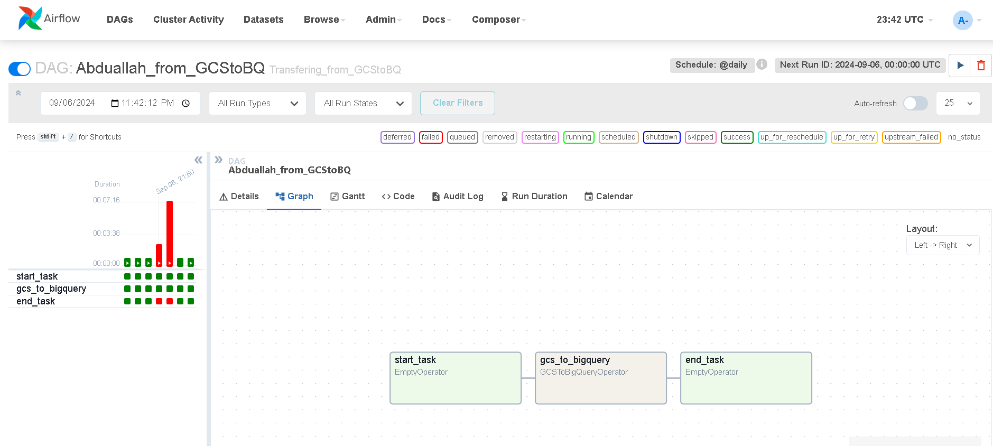

DAG

Slide 12
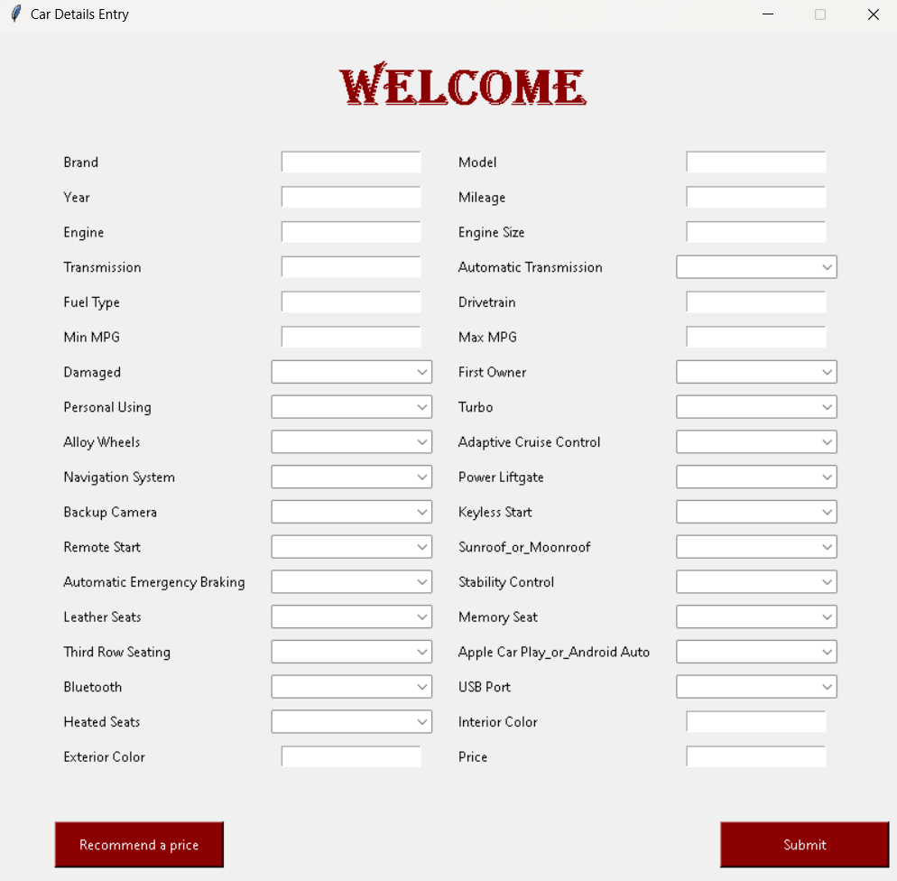
Tool

Slide 13
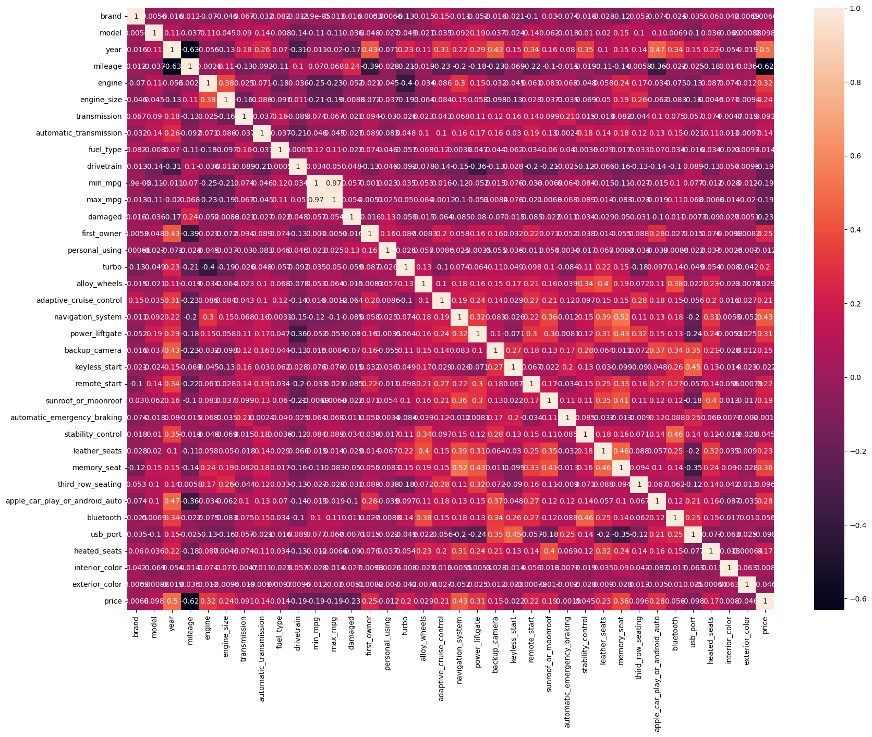
Relations between fields

Slide 14
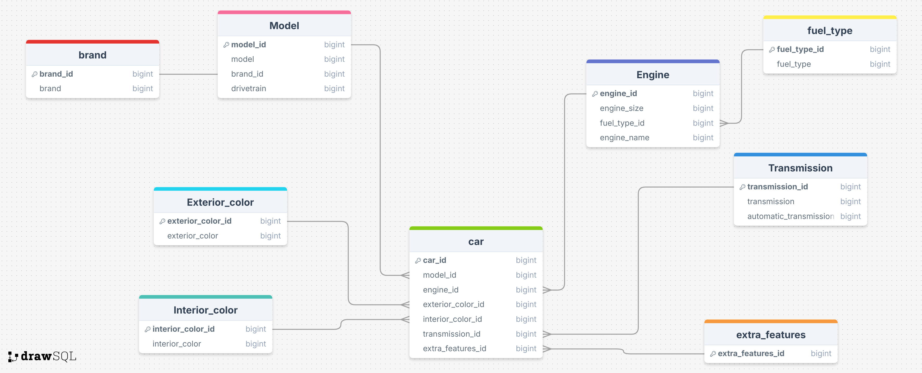
Stagging ERD

Slide 15
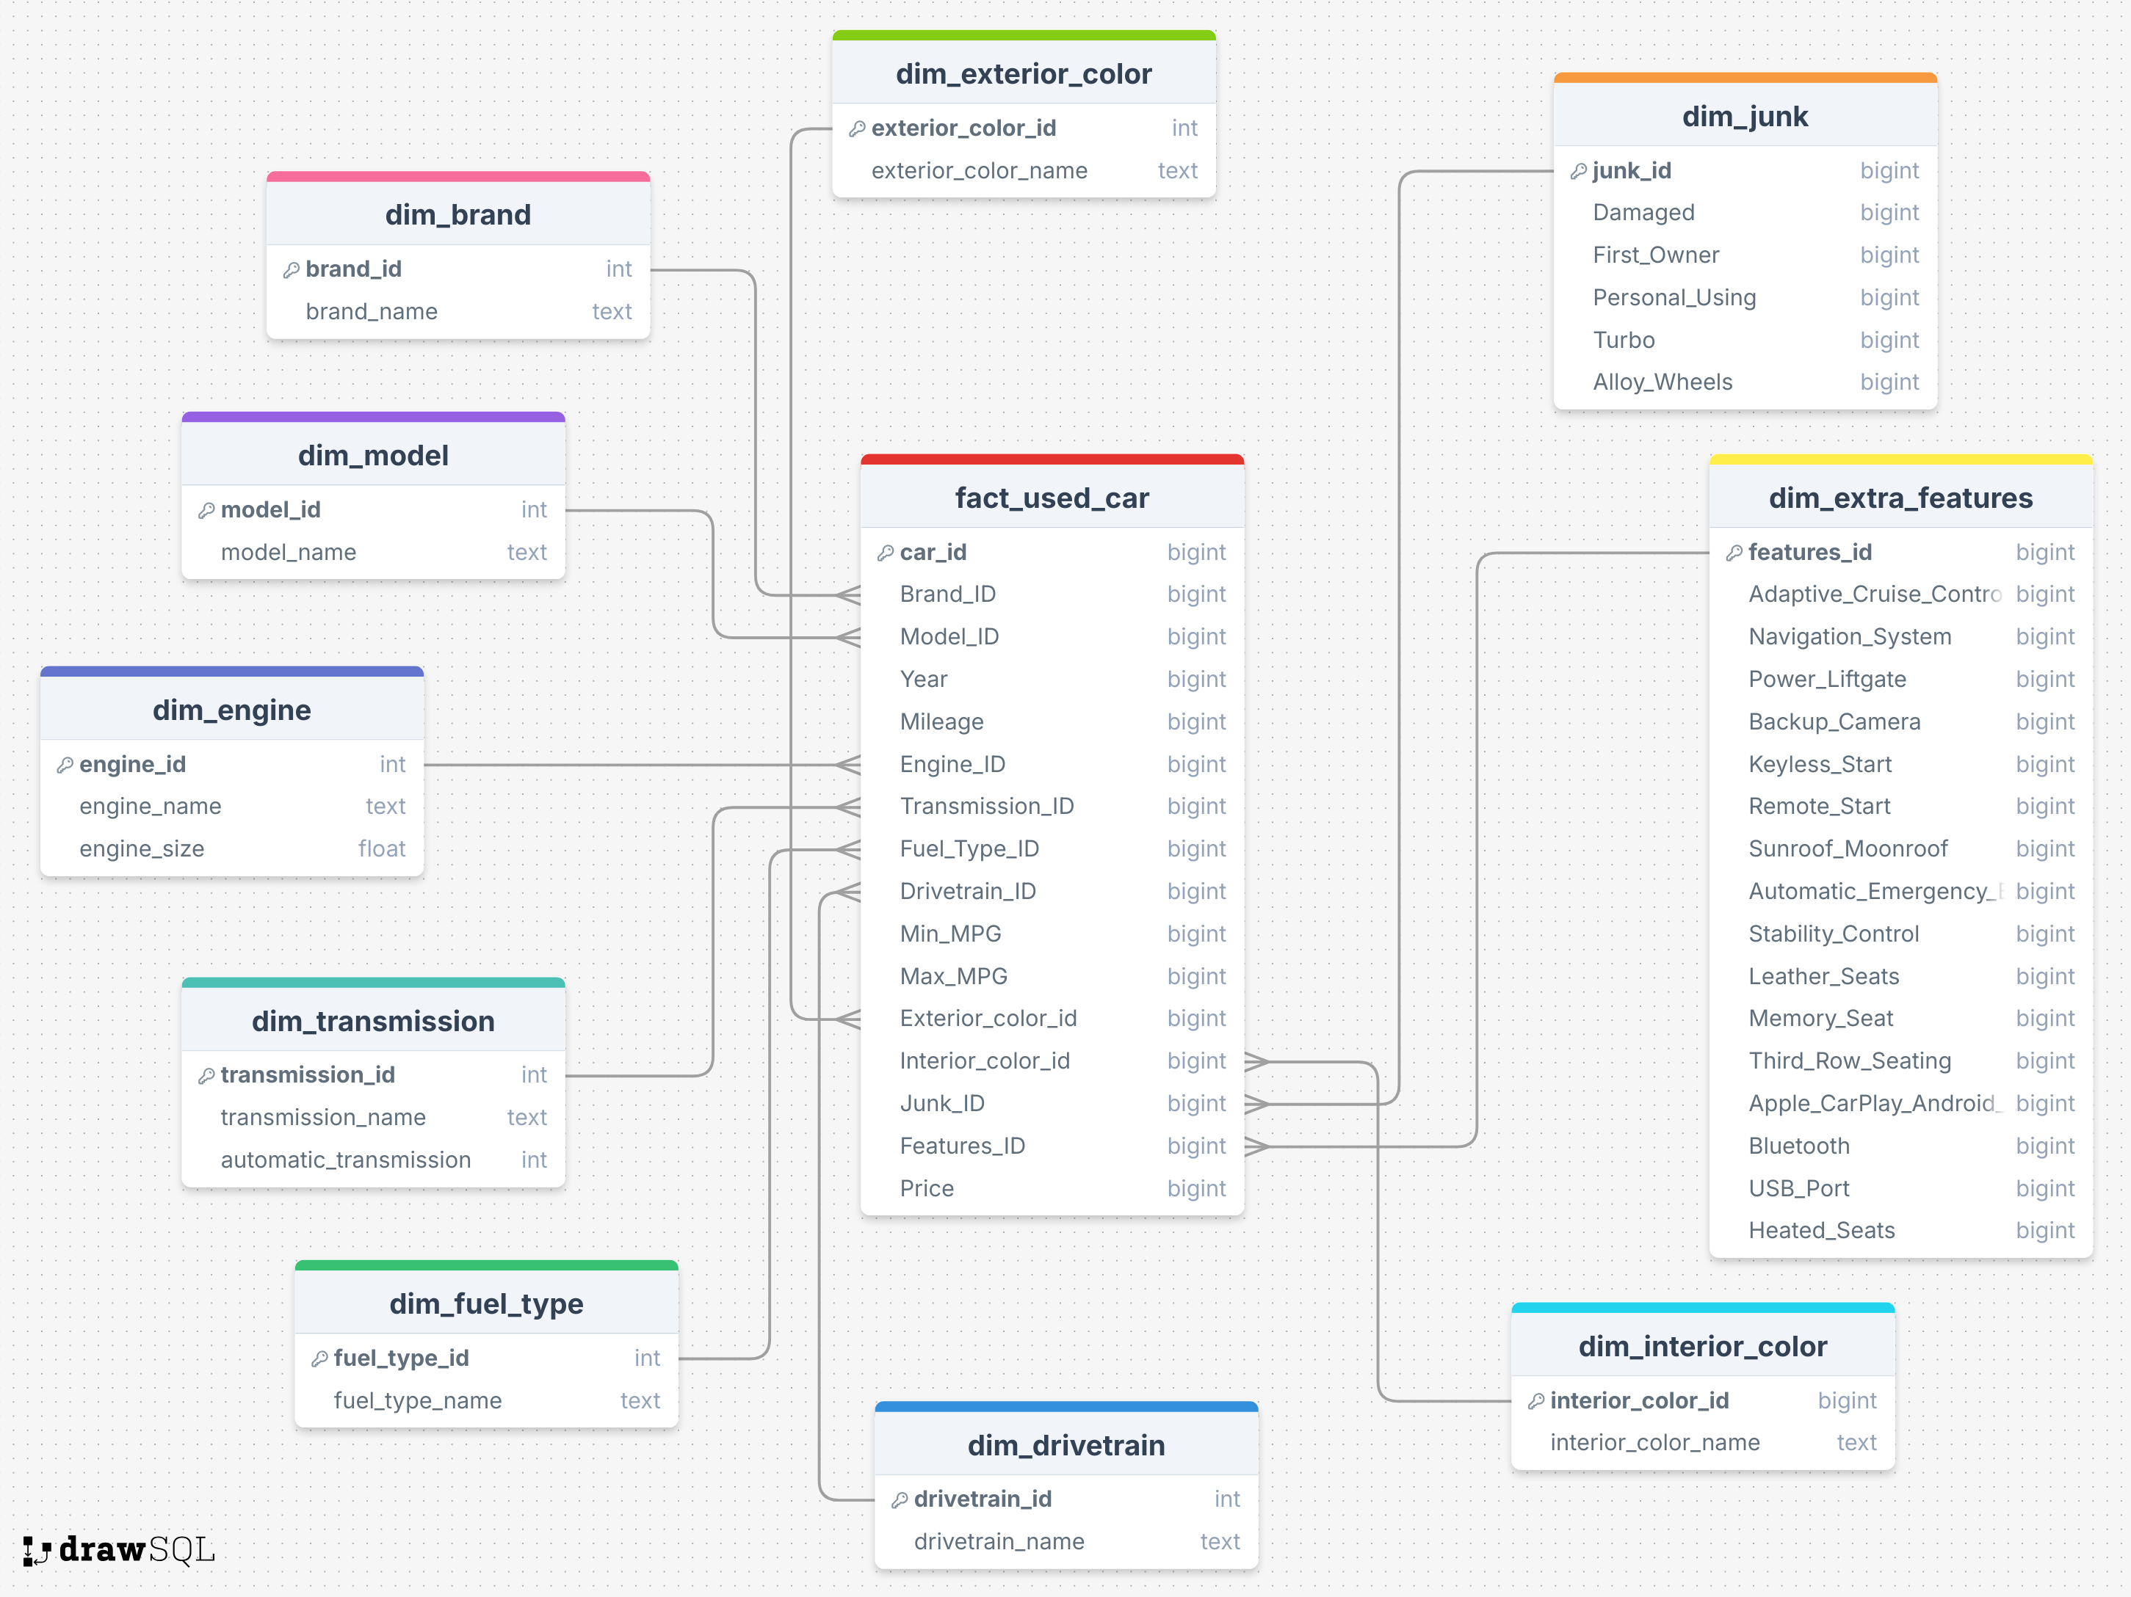
Star Schema ERD

Slide 16
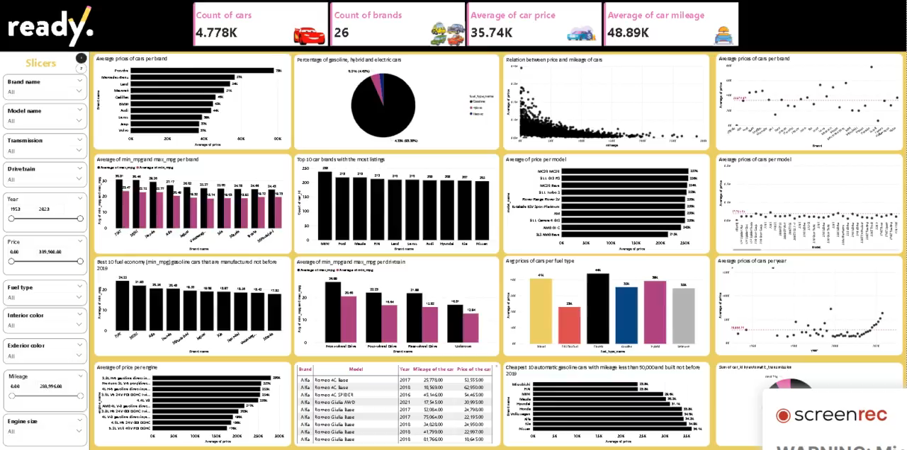
Dashboard

Slide 17
Demo

Slide 18

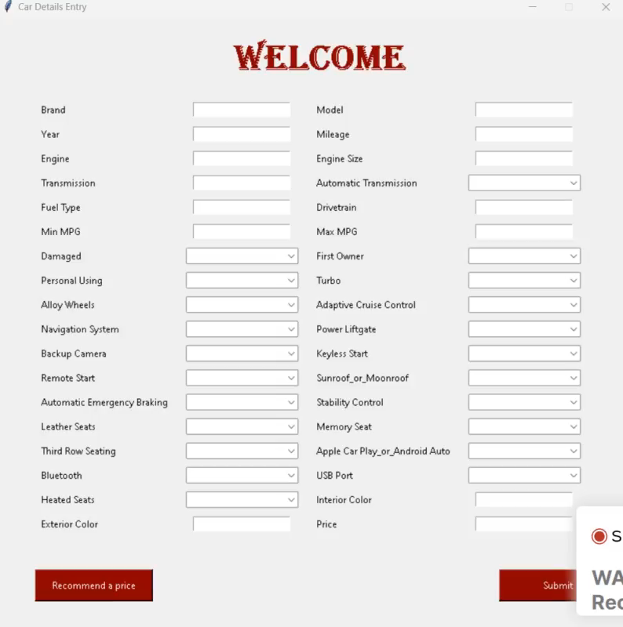
Running Demo

Slide 19
Future Work

Slide 20
What’s Next?
Apply data quality checks in dag
01
02
Put constraints on all the inputs
Emotion
Recognition
Increase the dataset size to enhance the ML model accuracy
03
04
Publish the dashboard and schedule refreshment of the dashboard to keep the data up-to-date.

Slide 21
Any Questions?

Slide 22
THANKS !

